Slide 1
CLC – Assignment 4
Ryan Coon Allen Atkins Carrie Assalone
CST-201
Prof. Jeremy Wright
December 19, 2021

Slide 2
Red-Black Tree

Slide 5
Why is a balanced Tree
desirable?

Slide 8
Big-O Analysis
Search in a balanced tree –
The find, insert and delete algorithms start at the tree root and a follow path down to, at worst
case, the leaf at the very lowest level. The total number of steps of these algorithms is,
therefore, the largest level of the tree, which is called the depth of the tree. The best (fastest)
running time occurs when the binary search tree is full or balanced – in which case the search
processes used by the algorithms perform like a binary search.

Slide 9
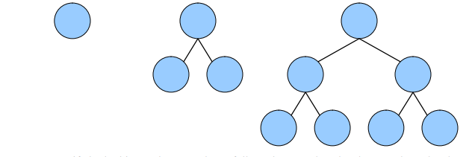
A full tree has 1 node at level 0, 2 nodes at level 1, 4 nodes at level 2 and so on. Thus, it
will have 2d nodes at level d. Adding these quantities, the total number of nodes n for a
full binary tree with depth d is:
n = 20 + 21 + 22 + … + 2d = 2d+1 − 1

Slide 10
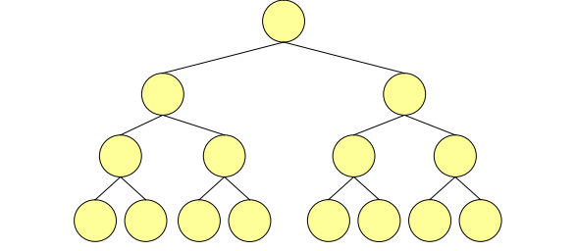
Now, considering the formula above for the number of nodes in a full binary search tree:
n = 2d+1 − 1
Solving for d, we get:
N + 1 = 2^{d+1}
lg(n + 1) = lg(2^{d+1})
lg(n + 1) = (d + 1)lg(2)
lg(n + 1) = d + 1
d = lg(n + 1) – 1
d = [lg(n)]

Slide 11
For example, the depth of a full binary search tree with 15 nodes is 3. In other words, the
depth of a binary search tree with n nodes can be no less than lg(n) and so the running
time of the find, insert and delete algorithms can be no less than lg(n). A full binary search
tree is said to be balanced because every node's proper descendants are divided evenly
between its left and right subtrees. Thus, the search algorithm employed by the find, insert
and delete operations perform like a binary search.

Slide 12
As a binary search tree becomes more and more unbalanced, the performance
of the find, insert and delete algorithms degrades until reaching the worst case of O(n),
where n is the number of nodes in the tree. For example, the number of comparisons needed
to find the node marked A in the binary search trees below is 3, which is equal to the
number of nodes.

Slide 13
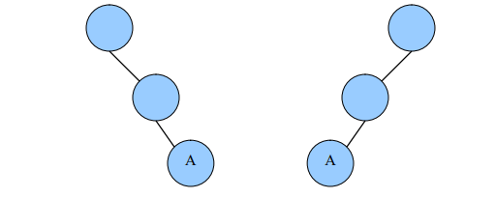
Binary search trees, such as those above, in which the nodes are in order so that
all links are to right children (or all are to left children), are called skewed trees.
The average running time of the binary search tree operations is difficult to establish
because it is not clear that all binary search trees are equally likely.1 It has been proven
that when a binary search tree is constructed through a random sequence of insertions
then the average depth of any node is O(lg n).

